Slide 1
ACM Tools
ACM Research, Inc.
2021-5-13

Slide 2
ACM 12寸WET设备
 |  | 应用 | 类型 | New or Used | 型号 | 化学药液
WET | 1 | 前段晶圆颗粒清洗 | Single | New | Ultra C s II (Single 8 Chambers) | CO2DIW
WET | 2 | 后段晶圆颗粒清洗 | Single | New | Ultra C s II (Single 8 Chambers) | CO2DIW
WET | 3 | 背面刻蚀和清洗去胶 | Single | New | Ultra C b (Single 4 Chambers) | 2CH: HNO3/HF, CO2DIW 2CH: DSP+, CO2DIW
WET | 4 | Thin wafer | Single | New | Ultra C b (Single 2 Chambers) | SPIN D, SPIN E, DHF, DIW

Slide 3
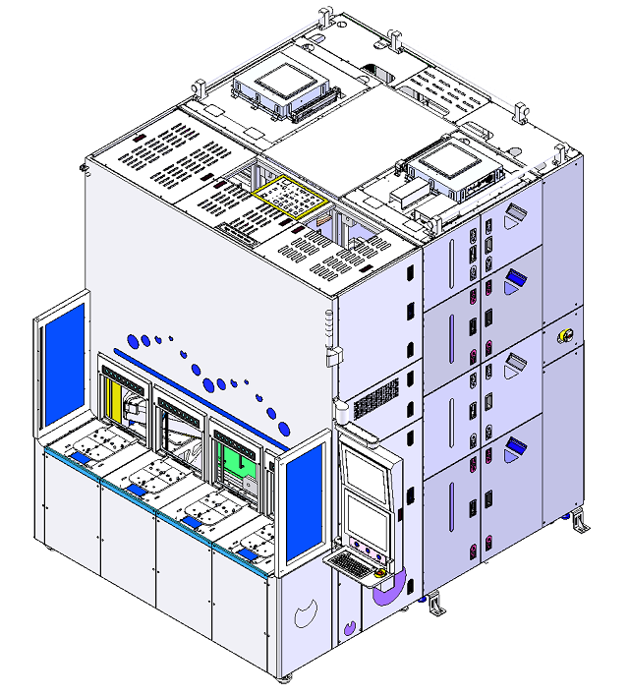
1.Scrubber/Bevel clean(Single)
Process Application: Scrubber/Bevel Clean
Model: Ultra C 318
Chamber Count: 8ea, 4 chamber N2 spray DICO2 + 4 chamber Brush
Robots: One index robot with 2ea arms, one process robot with 2ea arms
Chuck: Mechanical&Vacuum Chuck, with conductive pin
Clean: Wafer front side, backside, Bevel
Physical Assist Clean: N2 spray DICO2/DIW, Brush
Dry Method: Spin dry; N2 spin dry
Chemical Configuration:
Particle:
<20ea@40nm, Bare Si
Metal contamination (ICPMS): <5E9 atm/cm^2
Etch Rate Uniformity(%): N/A
Ultra C 318 Basic Feature
Chemical | Front | Back | Temp. | Conc. | Reclaim/to Drain
DICO2/DIW | v | v | RT | 0.1MΩ*cm | to Drain
N2 Spray DICO2/DIW | v |  | RT | 0.1MΩ*cm | to Drain
W*L*H= 2.242m*2.315m*2.85m

Slide 4
1.Scrubber/Bevel clean(Single) Configuration

Slide 5
1.Scrubber & Sub unit Layout Overview
Ultra C 318
W*L*H=
2.242m*2.8034m*2.85m
W*D*H= 2.35*6.125*2.85
3F
2.5F
2F

Slide 6
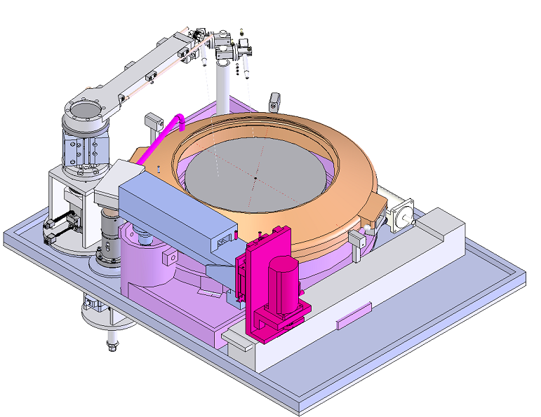
1.Frontside Clean Chamber Config
Chamber Nozzle Configuration
Arm 1 | Bevel Brush
Arm 2 | NANO CO2 DIW, CO2 DIW
Arm 3 | N2
Nozzle&drain configuration
Nozzle1:CO2 DIW
Fix Nozzle
Nozzle2:CO2 DIW
Swing Arm2
Wafer Get & Put
FFU
Nozzle1:Nano CO2/DIW
Nozzle2:CO2/DIW
Swing Arm1Arm1
Swing Arm2
Bevel Brush
NANO CO2 DIW
Swing Arm3
CO2 DIW
N2
Fix DIW 1& 2
Swing Arm3
N2
Vacuum Chuck
Swing Arm1
Backside Nozzle1:CO2 DIW
Backside Nozzle2: N2
Bevel Brush
CO2 DIW Drain
Back Side
Exhaust
Nozzle1:CO2 DIW
Nozzle2:N2
6

Slide 7
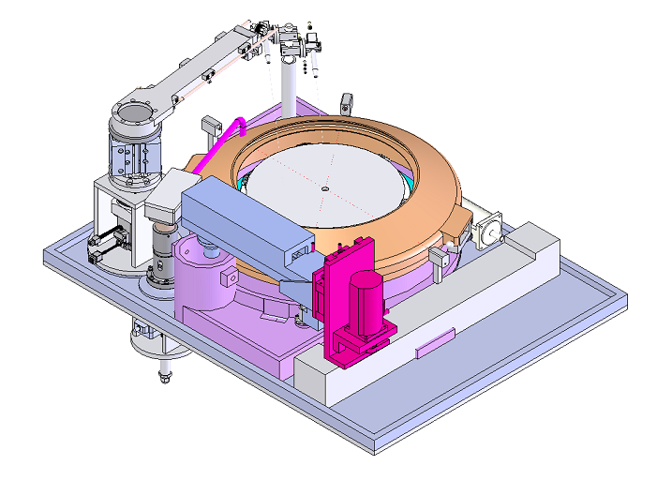
Chamber Nozzle Configuration
Arm 1 | Backside Brush
Arm 2 | NANO CO2 DIW, CO2 DIW
Arm 3 | N2
1.Backside Clean Chamber Configuration
Nozzle&drain configuration
Fix Nozzle
Swing Arm2
Nozlzle1:NANO CO2/DIW
Nozzle1:CO2 DIW
Nozzle2:CO2 DIW
FFU
Nozzle2:CO2/DIW
SW1
SW2
Backside Brush
NANO CO2 DIW
CO2 DIW
Fix DIW 1& 2
SW3
N2
Swing Arm3
N2
Swing Arm1
Backside Nozzle: N2
Backside Brush
Common
Drain
Exhaust
Back Side
Nozzle1:CO2 DIW
Nozzle2:N2
7

Slide 8
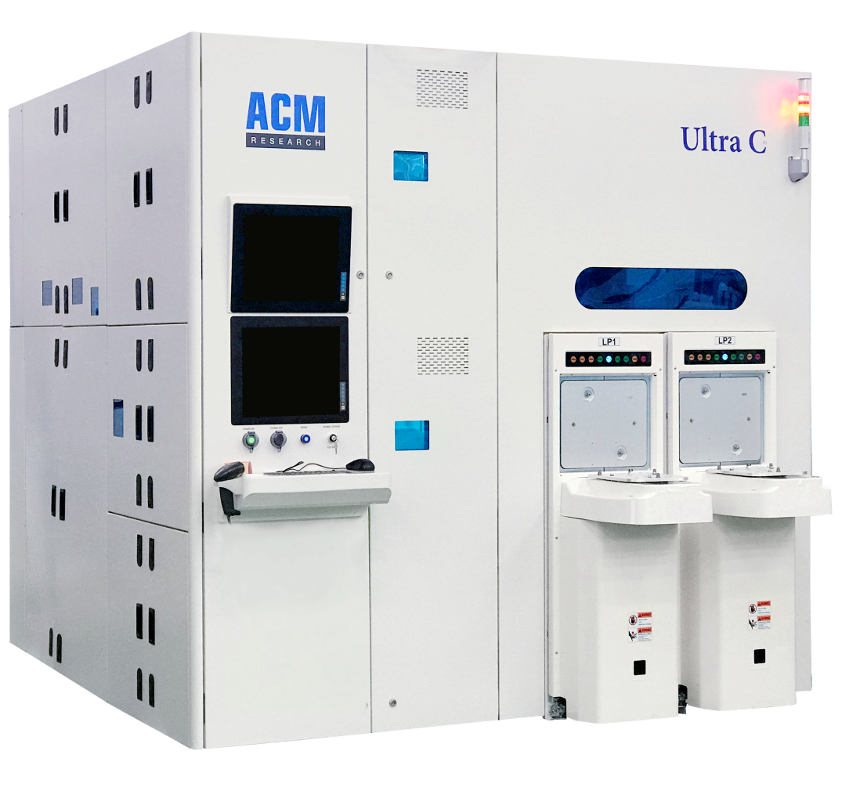
2. Backside Clean + DSP Clean
Process Application: Backside Clean + DSP Clean
Chamber Count: 4ea
Robots: One robot with two arms
Chuck: Bernoulli chuck
Dry Method: Spin dry; N2 spin dry
Chemical Configuration:
Particle:
Wafer front side: 0.12um ≤ 5ea; 0.060um≤ 20ea ;0.040um ≤ 40ea
Metal contamination (ICPMS): ≦1E+10 (atoms/cm2)
Etch Rate Uniformity(%): <3%, TOX
Chemical | Front | Back | Temp. | Conc. | Reclaim/to Drain
HNO3/HF | v |  | R.T~30℃, 23±0.5 | HF:HNO3=1:10 -1:100 | Reclaim
CO2_DIW/DIW | V |  | RT | 0.2MΩ*cm | to Drain
DSP | v |  | R.T~30℃, 23±0.5 |  | Reclaim
W*L*H=2580mm*2460mm*2410mm

Slide 9
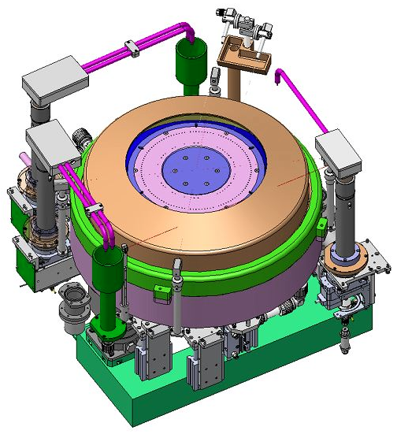
2. Backside Clean Chamber Configuration
Chamber 1-2
Swing arm2
Nozzle1: DIW CO2
Swing arm3
Nozzle1: N2
Inner Tray
HNO3/HF Reclaim
HNO3/HF Drain
Inner Shroud up, liquid flow into the inner tray, for HNO3/HF reclaim and HNO3/HF drain
Swing arm1
Outer Tray
Nozzle1: HNO3/HF
Common Drain
HNO3/HF rinse Drain
Inner shroud down, liquid flow into the outer tray, N2 dry and pre and post rinse drain.

Slide 10
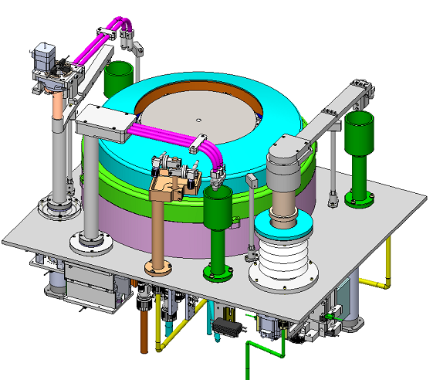
2.Chamber Configuration (DSP)
Chamber 3-4
Swing arm3
Swing arm2
Nozzle1: N2
Inner Tray
Nozzle2: CO2 DIW/DIW
DSP+ Reclaim
DSP+ Drain
Inner Shroud up, liquid flow into the inner tray, for DSP+ reclaim and drain.
Outer Tray
Swing arm1
Common Drain
Nozzle1: DSP+
DSP+ Post rinse Drain
Inner shroud down, liquid flow into the outer tray, N2 dry and pre and post rinse drain

Slide 11
4. Thin Wafer Backside Clean (Single)
Process Application: Thin wafer backside Si wet etch
Chamber Count: 2ea(4chamber platform with 2ea chamber mounted)
Robots: Bernoulli arm
Chuck: Bernoulli chuck
Dry Method: Spin dry; N2 spin dry
Chemical Configuration:
Si thickness monitor unit: Installed
Particle:
Si-Etchant - DHF<50ea@120nm
Metal contamination (ICPMS): <5E10 atm/cm^2
Etch Rate Uniformity(%): <3%, TOX
Wafer thickness: 200um or 200um Taiko wafer or bonding wafer
Wafer warpage: +/-5mm
Bath | Front | Back | Temp. | Conc. | Reclaim/to Drain
SPIN-E or SPIN-D | v |  | 30℃-60℃ |  | to reclaim
DHF | v |  | 23±1℃ | 1:10-1:50 | to reclaim
DIW | v |  | RT |  | to Drain
W*L*H=2580mm*2460mm*2410mm

Slide 12
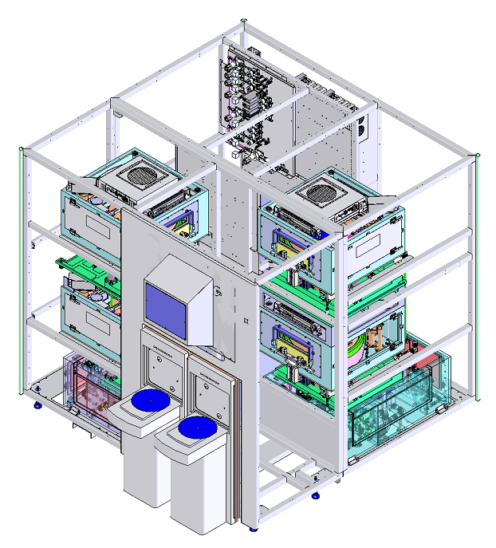
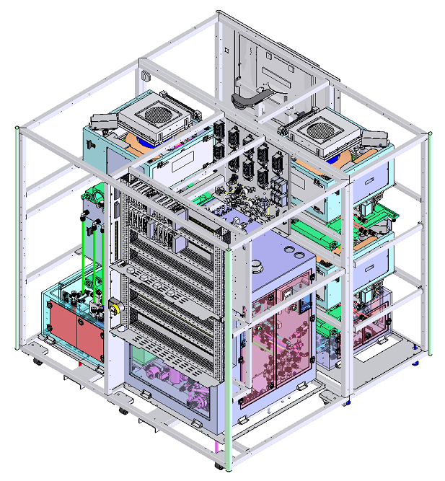
4.Thin Wafer Backside Clean (Single)
Ultra C b Basic Feature
N2 gas panel
Chamber D (不安装)
Chamber C (不安装)
Chamber B
Plumbing CD
Chamber A
Plumbing AB
loadport
robot
EE panel
Main Plumbing

Slide 13
4.Chamber Configuration
Inner Tray
Swing arm2
Si Etchant 1 Reclaim
Nozzle1: DIW
Swing arm3
Si Etchant 1 Reclaim
Nozzle2: DHF
Nozzle1: N2
Middle Tray
HF Reclaim
HF Drain
Swing arm1
Nozzle1: Si Etchant
Outer Tray
Common Drain

Slide 14
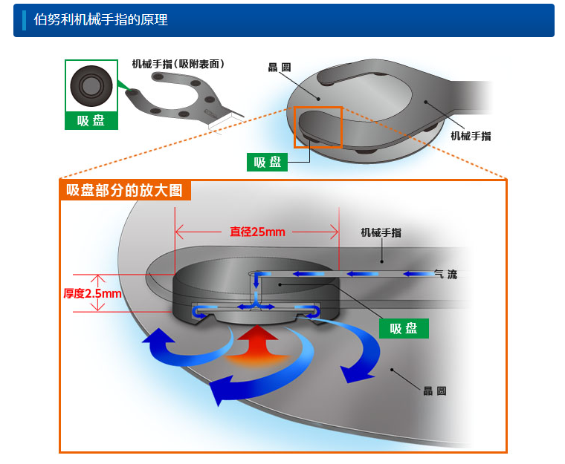
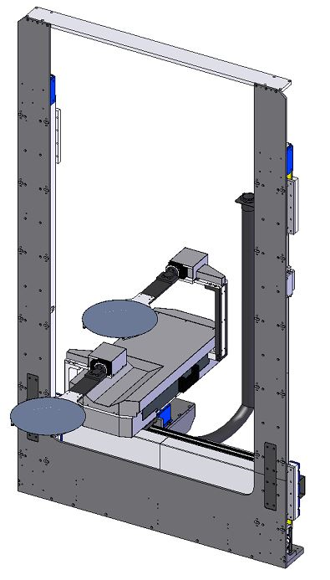
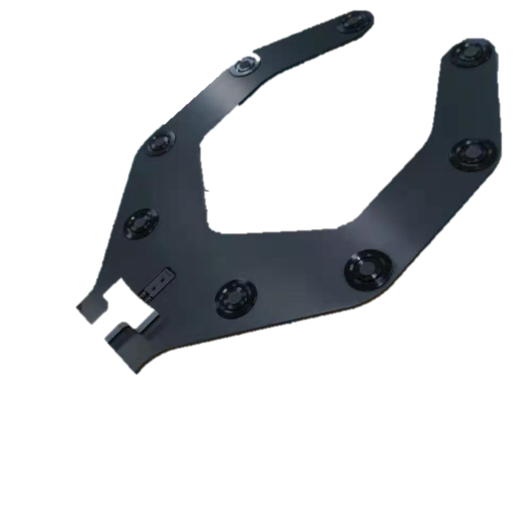
4.Thin Wafer Robot Transfer-Bernoulli arm
Wafer Transfer Schedule
FOUP
Bernoulli arm
Weight stage
Flip
Bernoulli arm
Chamber
Flip
Bernoulli arm
Weight stage
Bernoulli arm
FOUP

Slide 15
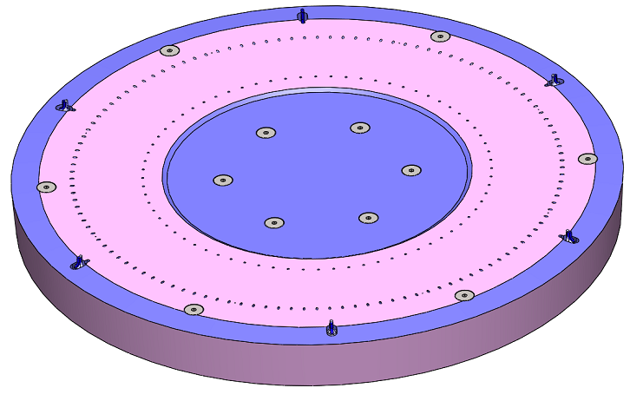
4.Chuck Configuration
Chuck pin
Advantage
Six Clamp pins: For preventing wafer horizontal movement during wafer
- each clamp pin is driven by an independent cylinder to move inwardly to hold wafer or outwardly
to release wafer
- 6 clamp pins are divided into two groups disposed alternately. During process, the two group alternately
holding/releasing wafer, so the wafer edge can be cleaned
Safety
Edge clean
Clamp pin
Bernoulli N2 holes

Slide 16
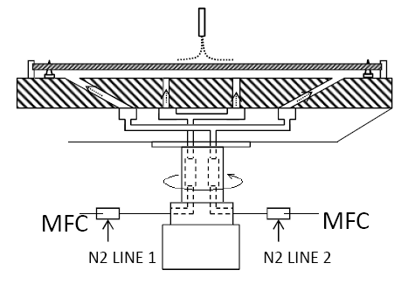
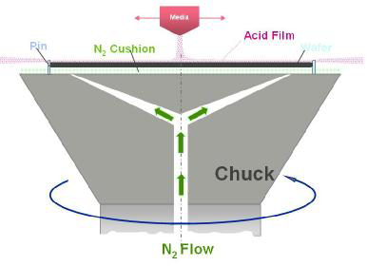
4.Chuck Configuration
Chuck comparison
ACM
L Company
Same Points
Application of Bernoulli Effect for Wafer floating, no touch between wafer Frontside and chuck
Different Points
ACM：Two types of N2 holes
– First type : inclined with certain angle, distributed on chuck periphery for provide Bernoulli effect source
– Second type : perpendicular, distributed around chuck center for wafer lifting
L：One type of N2 holes
– with certain angle distributed on chuck periphery for provide Bernoulli effect source

